Slide 1
Pizza sales analysis project (sql)
By Sanjana Dalvi

Slide 2
Introduction
The Pizza Sales Analyst project focuses on leveraging SQL to analyze a dataset containing sales information for a pizza delivery business. The goal of this project is to uncover valuable insights that can help the business optimize operations, understand customer preferences, and boost profitability.
Dataset Overview: The dataset used for this analysis contains comprehensive data on pizza orders over a specified period. It includes:
Order Details
Orders
Pizzas
pizza types
Key Objectives:
Sales Trend Analysis: Identify trends in sales over time, including the most popular days, weeks, and months for pizza orders.
Pizza Preferences: Analyze which pizza types and sizes are most popular among customers.
Revenue Insights: Determine which pizzas generate the highest revenue and identify opportunities to increase profitability.
Store Performance: Compare the sales performance of different store locations to evaluate their productivity and profitability.
Customer Behavior: Understand customer ordering patterns and identify repeat customers and customer demographics that generate the most sales.

Slide 3
Project Approach: Using SQL, this project involves querying the database to extract insights, perform aggregation, and visualize data trends. Techniques such as joins, subqueries, and window functions are applied to analyze sales data efficiently. The final analysis aims to provide actionable recommendations that can assist in business decision-making, such as marketing strategies and inventory management.
Basic:
Retrieve the total number of orders placed.
Calculate the total revenue generated from pizza sales.
Identify the highest-priced pizza.
Identify the most common pizza size ordered.
List the top 5 most ordered pizza types along with their quantities.
Intermediate:
Join the necessary tables to find the total quantity of each pizza category ordered.
Determine the distribution of orders by hour of the day.
Join relevant tables to find the category-wise distribution of pizzas.
Group the orders by date and calculate the average number of pizzas ordered per day.
Determine the top 3 most ordered pizza types based on revenue.
Advanced:
Calculate the percentage contribution of each pizza type to total revenue.
Analyze the cumulative revenue generated over time.
Determine the top 3 most ordered pizza types based on revenue for each pizza category.

Slide 4
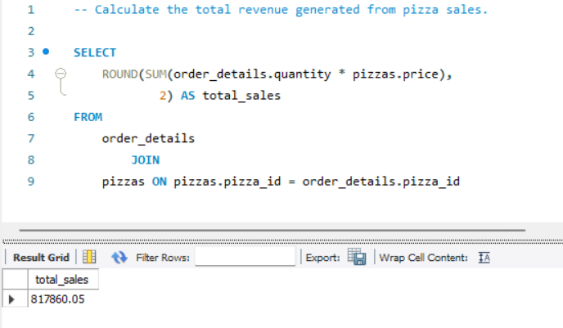
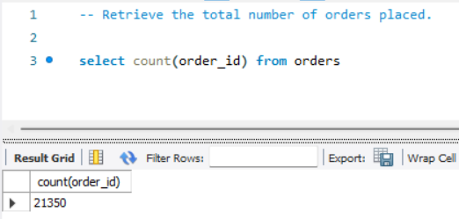
Basic Queries
1.
2.

Slide 5
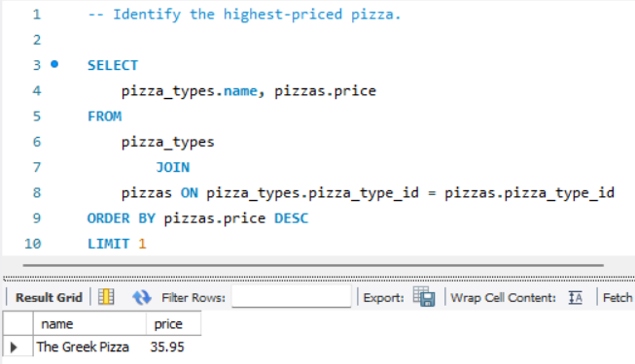
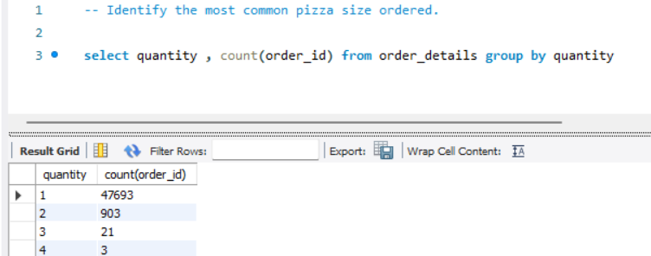
3.
4.

Slide 6
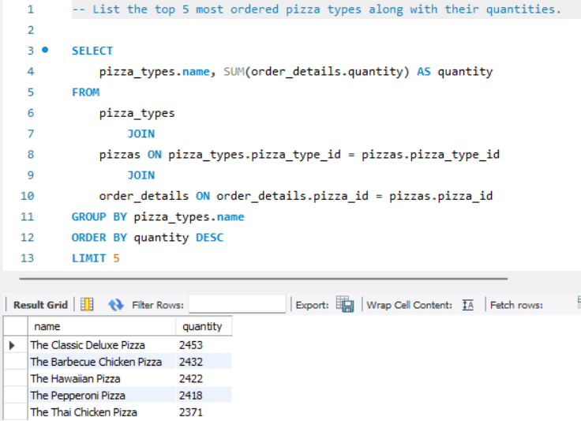
5.

Slide 7
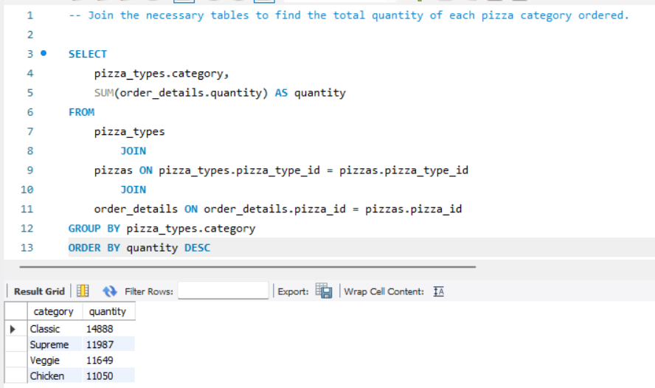
Intermediate
1.

Slide 8
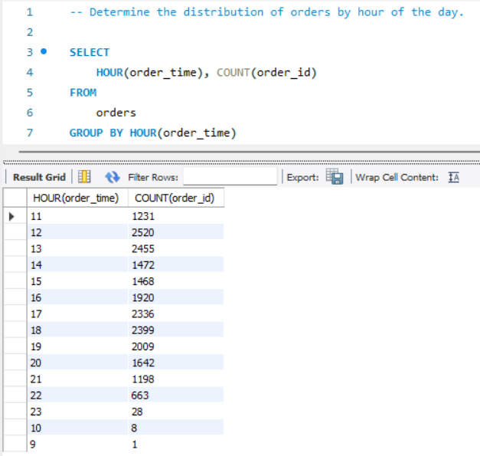
2.

Slide 9
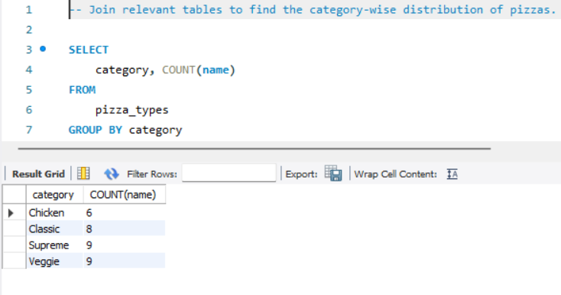
3.

Slide 10
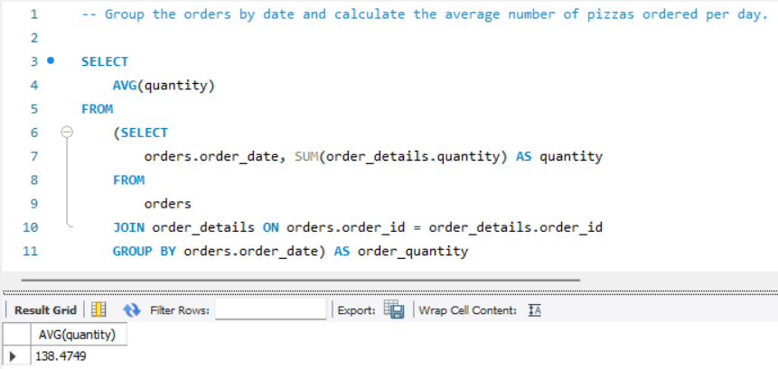
4.

Slide 11
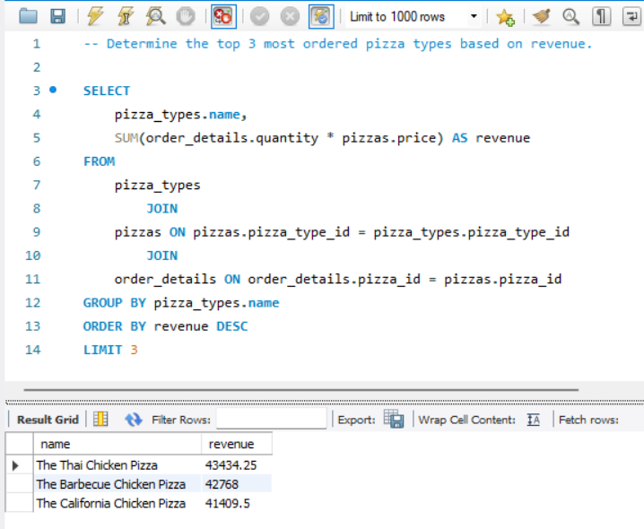
5.

Slide 12
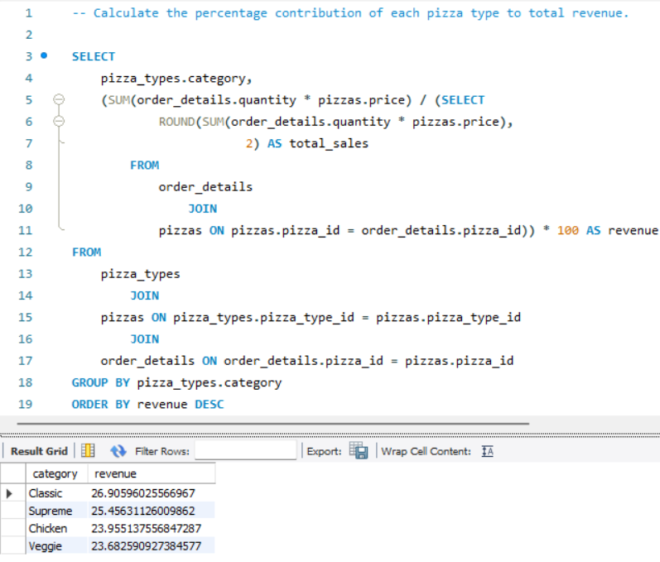
Advance
1.

Slide 13
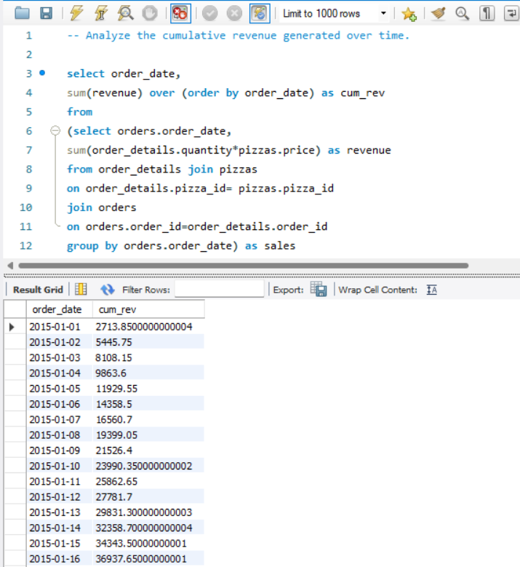
2.

Slide 14
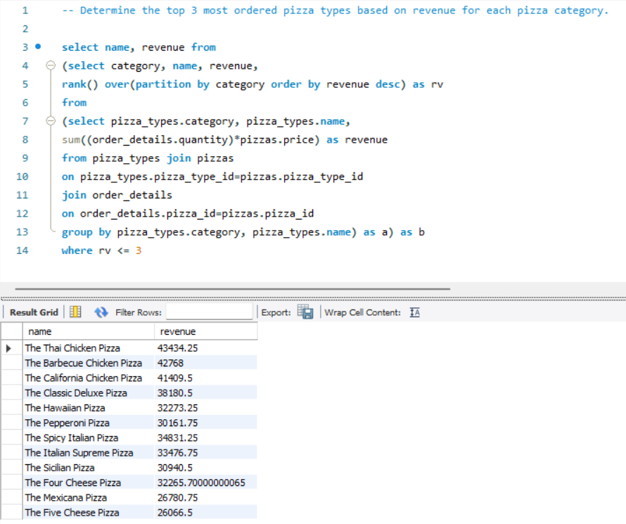
3.

Slide 15
Thank You

